Slide 1
1
SPL – 1 Final Presentation
Prepared by:
Mohammad Ismail Hossain
BSSE - 1433
Topic:
Typing Master: An Interactive Typing Tutor and Typing Game
Supervised by:
Dr. Emon Kumar Dey

Slide 2
2
Introduction of this project
“Typing tutor and Typing Game” project is an interactive application that aims to improve users’ typing skill through 3 major features.
Typing Tutorial feature provides some technique and helpful rules which can help users to improve typing skill.
Practice mode provides some structured exercises like key typing, word typing.
Typing Game feature adds a fun and interesting experience for users to test their accuracy and speed in an exciting challenging mood.

Slide 3
3
Objective of this Project
Improve Typing Speed
Improve Typing Accuracy
Performance Tracking
Performance Analysis
Provide Feedback

Slide 4
4
Main Features
Login System
Typing Tutorial
Typing Practice
Typing Game
Performance History and Analysis

Slide 5
5
The Problems and Challenges
Register & Login System
Accuracy & Speed Test
Users Performance Tracking
Performance Analysis
Bangla language support
Develop a timer
File Handling Operations

Slide 6
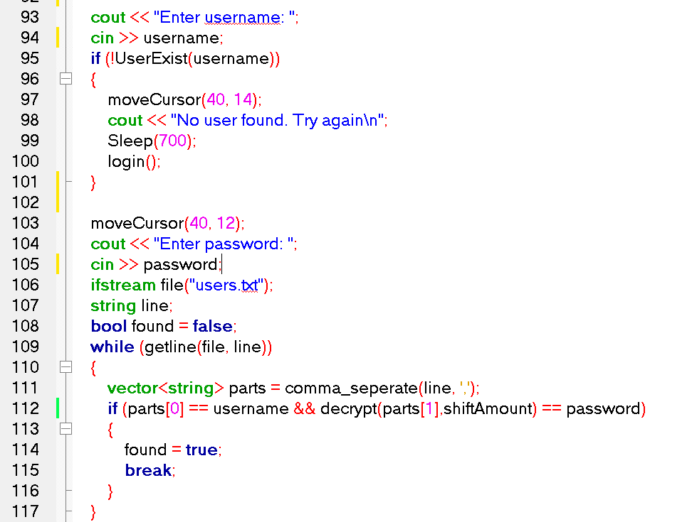
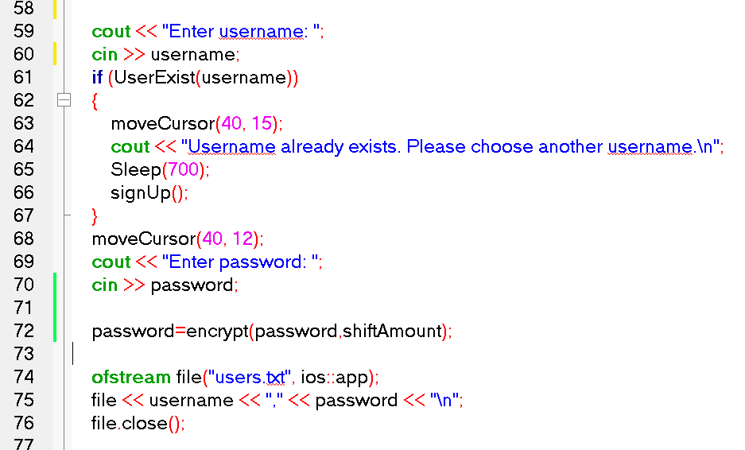
6
Login System
Code Example: log In
Code Example: Sign Up

Slide 7
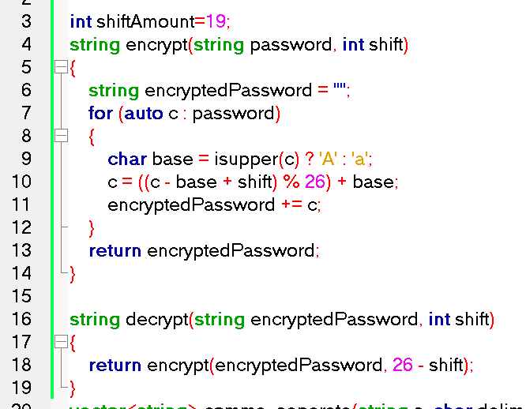
7
Login System
Password Encryption: Caesar Cipher Algorithm

Slide 8
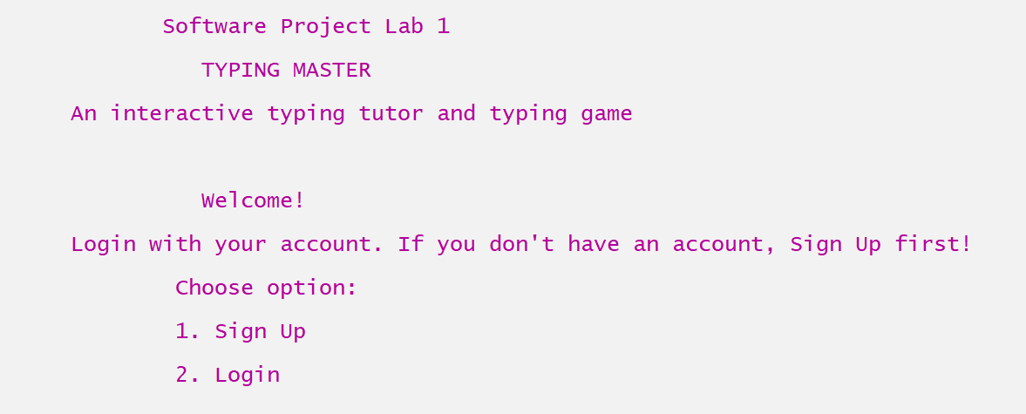
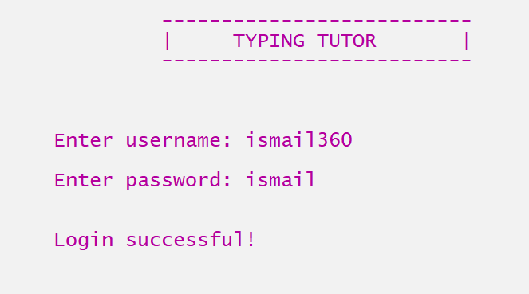
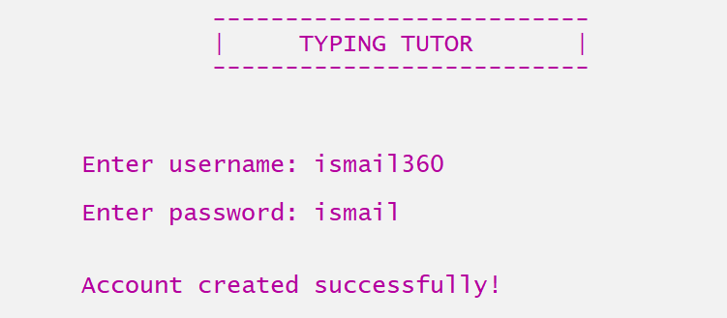
8
User Interface of Login System

Slide 9
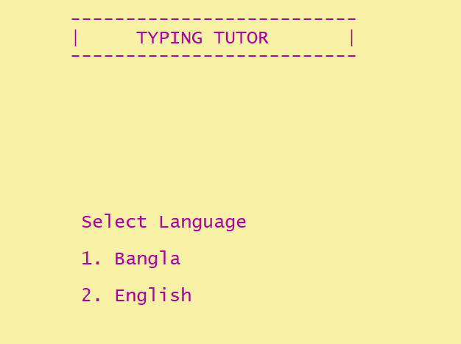
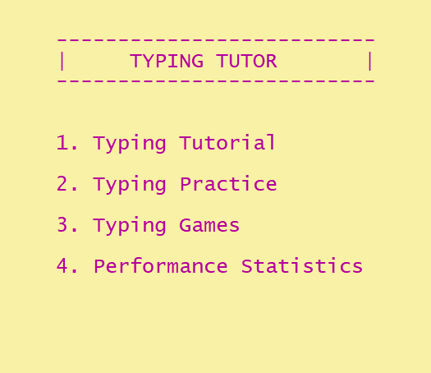
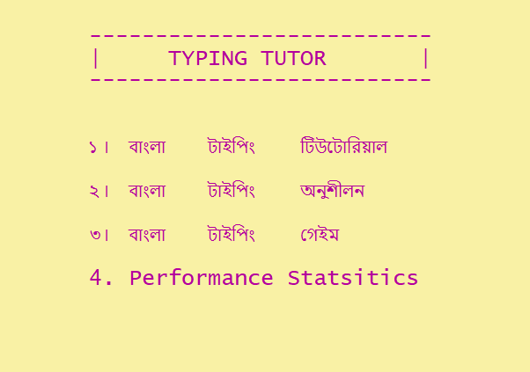
9
User Interface: Language Selection page & Home Page
Language Selection Page
Home Page (Bangla)
Home Page (English)

Slide 10
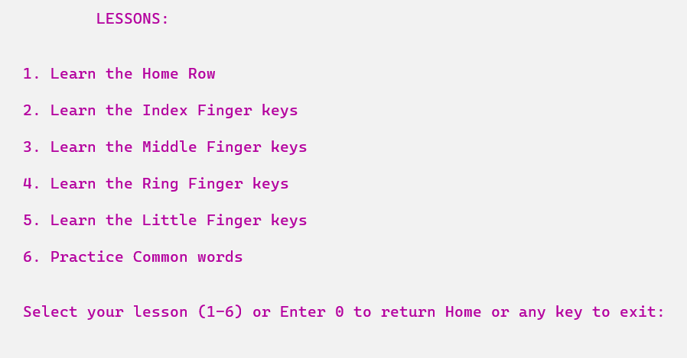
10
Typing Tutorial (English)
All keys are divided into 5 lessons
Some common words to practice

Slide 11
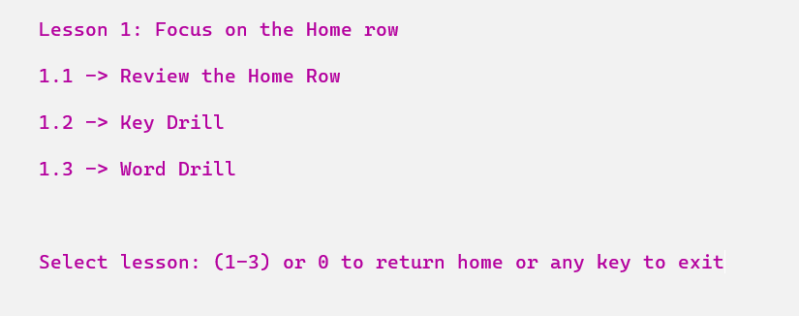
11
Feature in each Lesson
Interactively learn the keys
Practice on some randomly generated keys / words

Slide 12
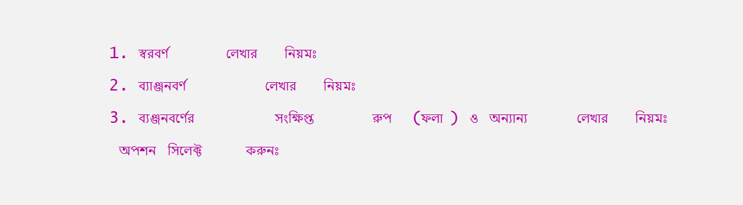
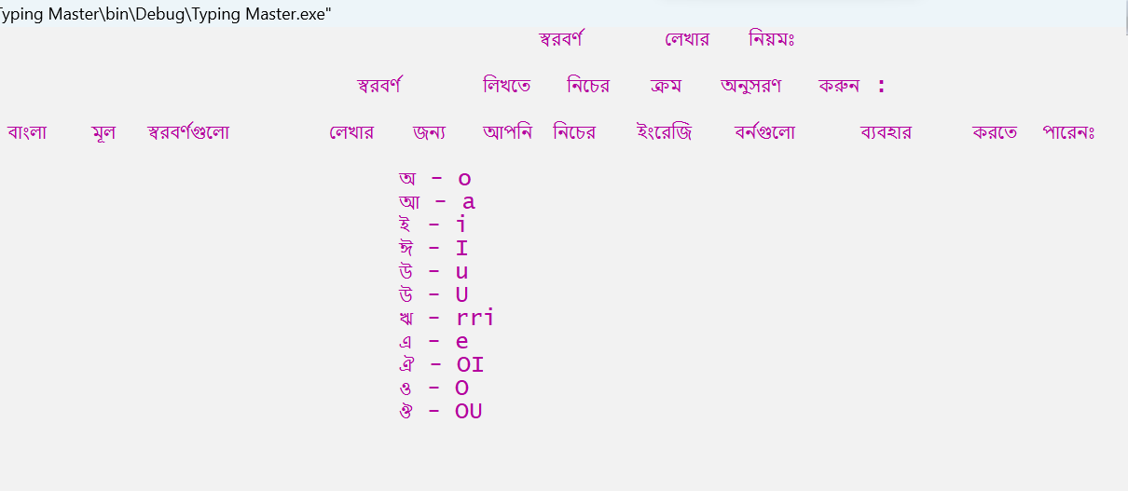
12
Typing Tutorial (Bangla)
Avro Phonetic Keyboard instructions

Slide 13
13
Bangla Language Support
Challenges:
C++ doesn't have built-in support for the Bangla language specifically. Use of Unicode & appropriate encoding is needed.
Bangla text to Hexadecimal Unicode Value conversion
Hexadecimal Unicode Value to Bangla Text
Unicode file read and output

Slide 14
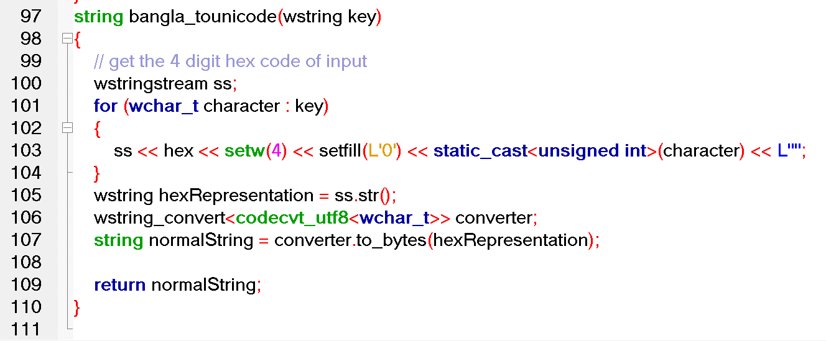
14
Convert Bangla text to Hexadecimal Unicode Value
Convert wide char to 4 digit Hexadecimal value
Convert the Hex value to UTF-8 encoded form
Code Example: Bangla text to Unicode conversion

Slide 15
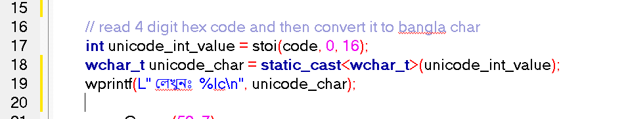
15
Convert Hexadecimal Unicode Value to Bangla Text
Convert 4 digit Hexadecimal value to wide character (wchar_t)
Use wprintf() / wcout function instead of cout
Code Example: Unicode to wide character conversion

Slide 16
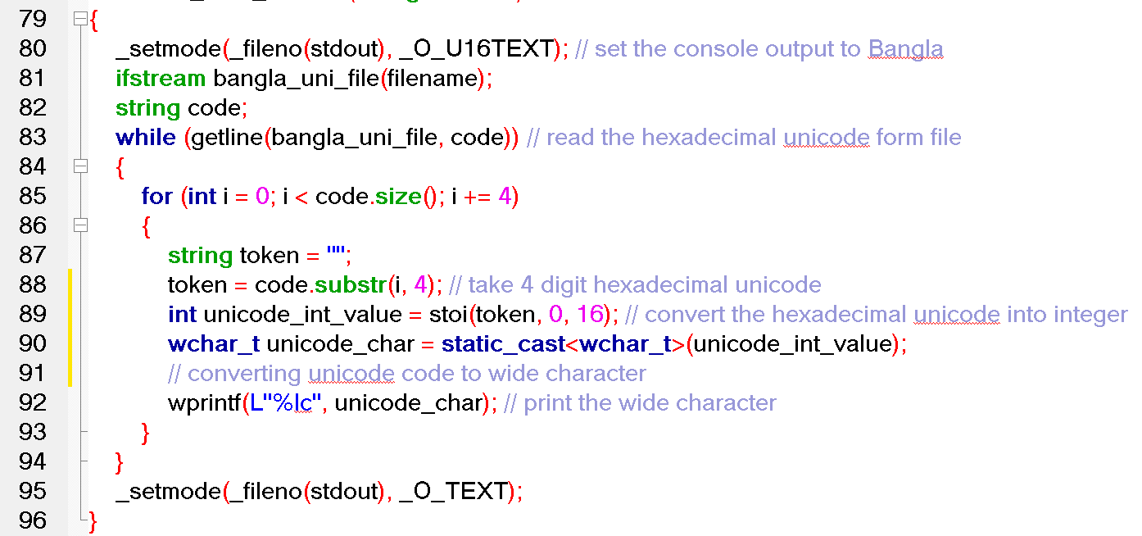
16
Unicode file read and output
Text file contains Unicode UTF-16 encoded Bangle text
Code Example: Unicode file read and output process

Slide 17
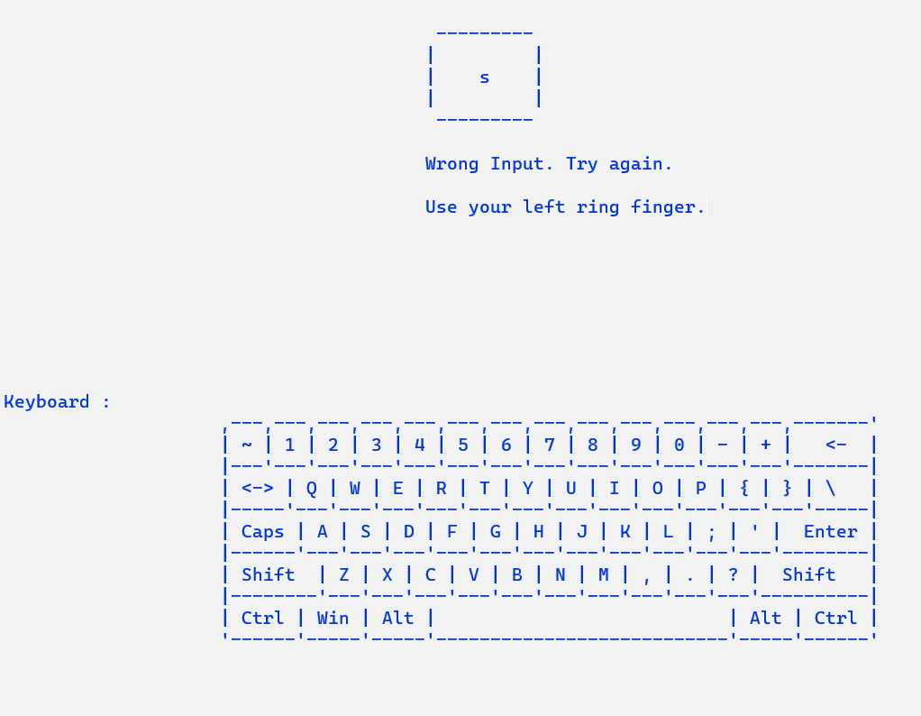
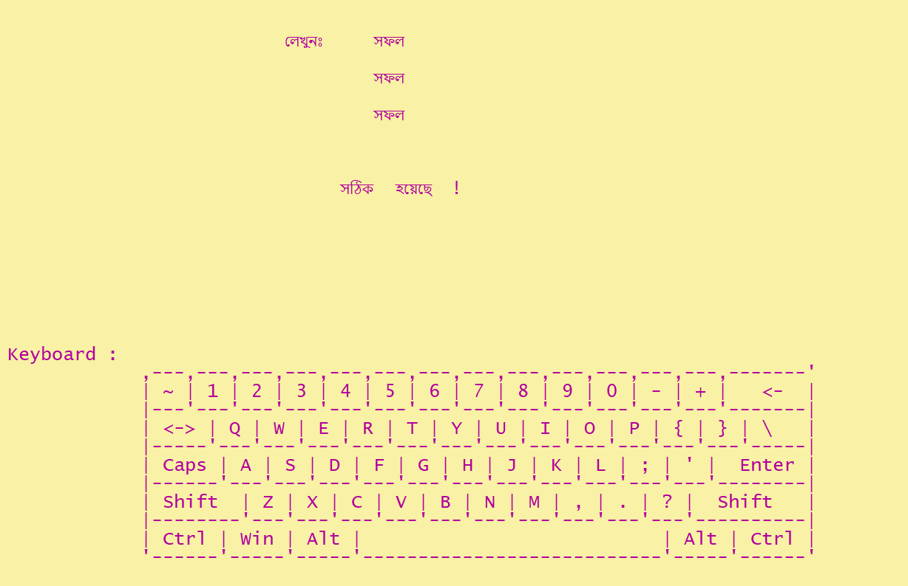
17
Typing Practice
User can select practice type and set a time limit.
Words will be randomly generated or taken from text file.
Practice page (English)
Practice page (Bangla)

Slide 18
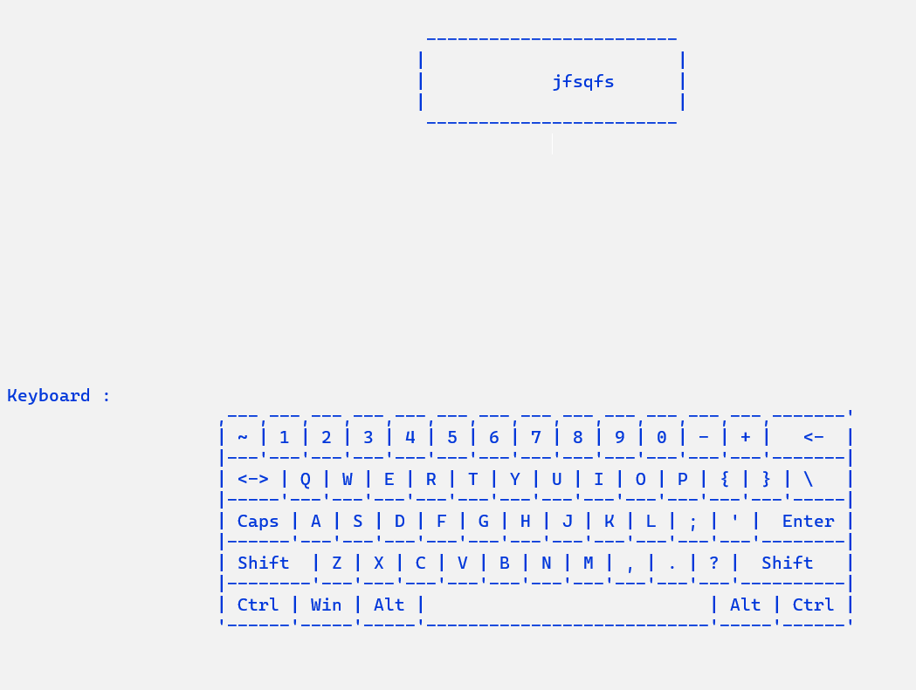
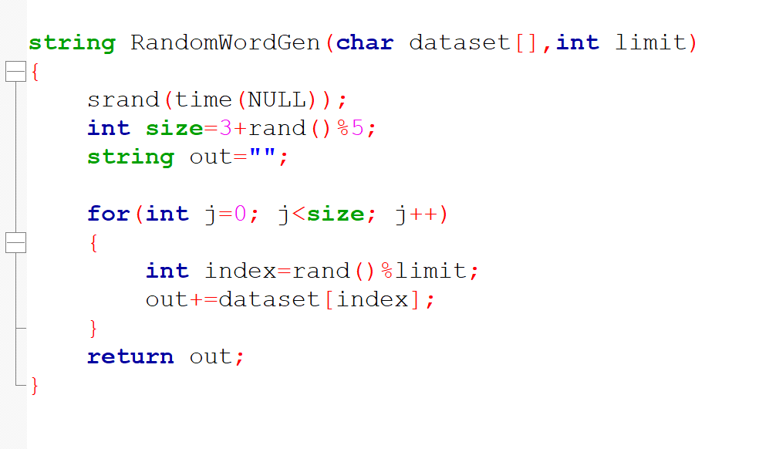
18
Random Word Generate
One of the most important functionalities in my project was to generate a random word / alphabet.
Code example: Random word generate

Slide 19
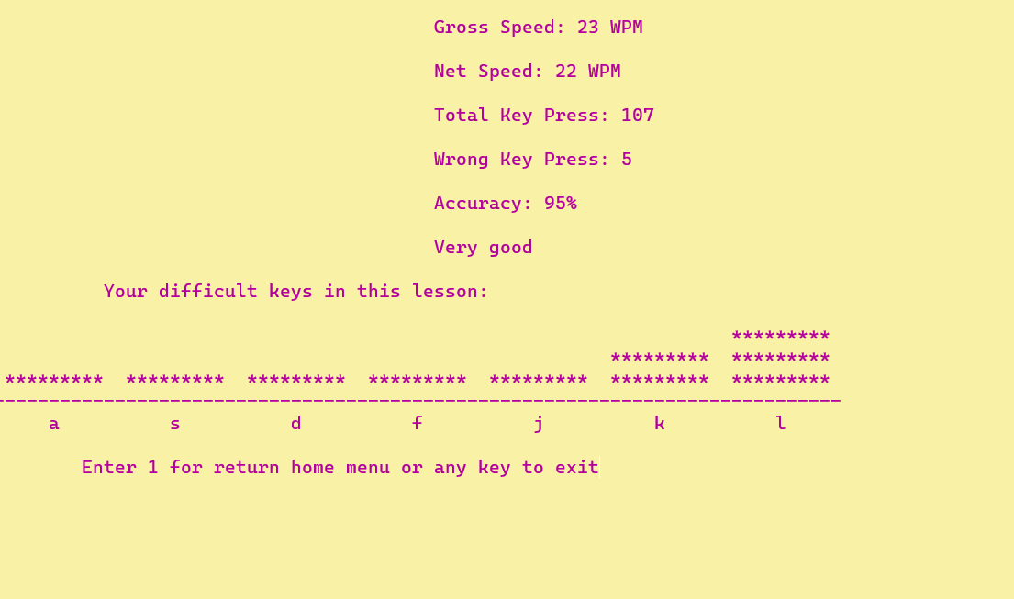
19
Performance Result
Gross Speed
Net Speed
Total Key Press
Wrong Key Press
Accuracy
Comment
Difficult Key Analysis using Histogram

Slide 20
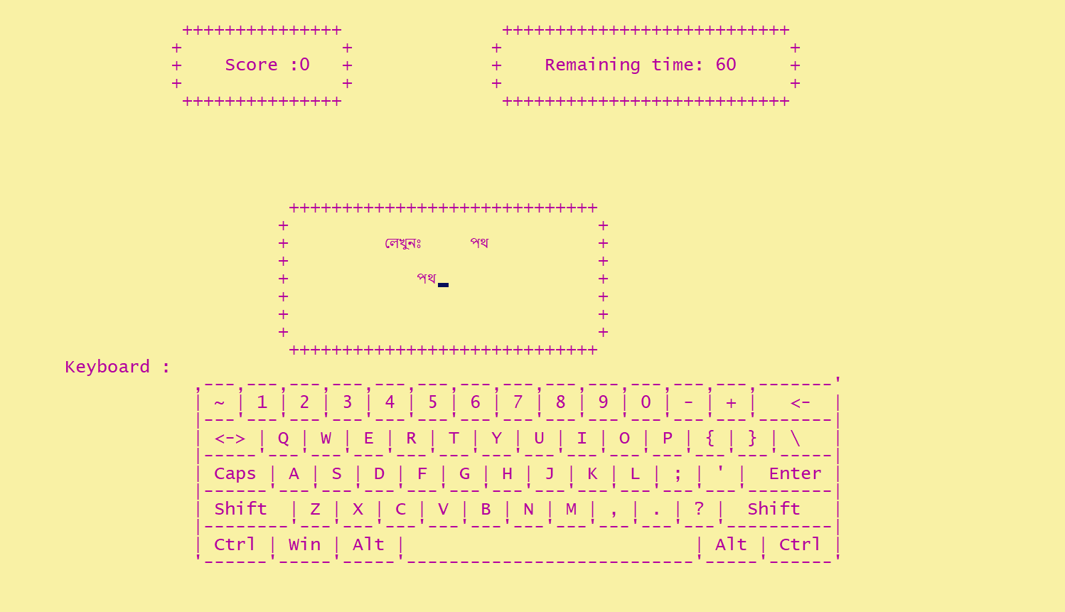
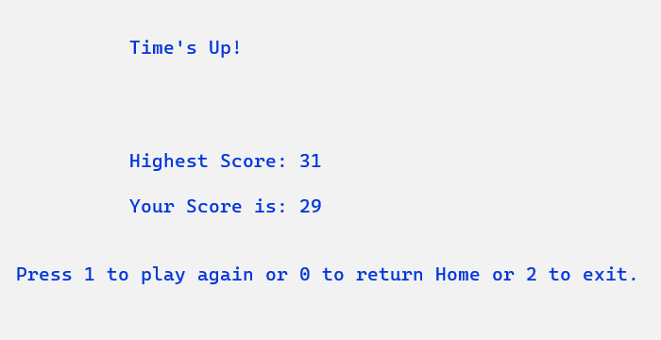
20
Game: Fast Typer
user will play for 60 seconds to type word as much as he can.
Highest score will be saved.
Words are taken from a text file.
Edit Distance (DP Algorithm) used to calculate score.

Slide 21
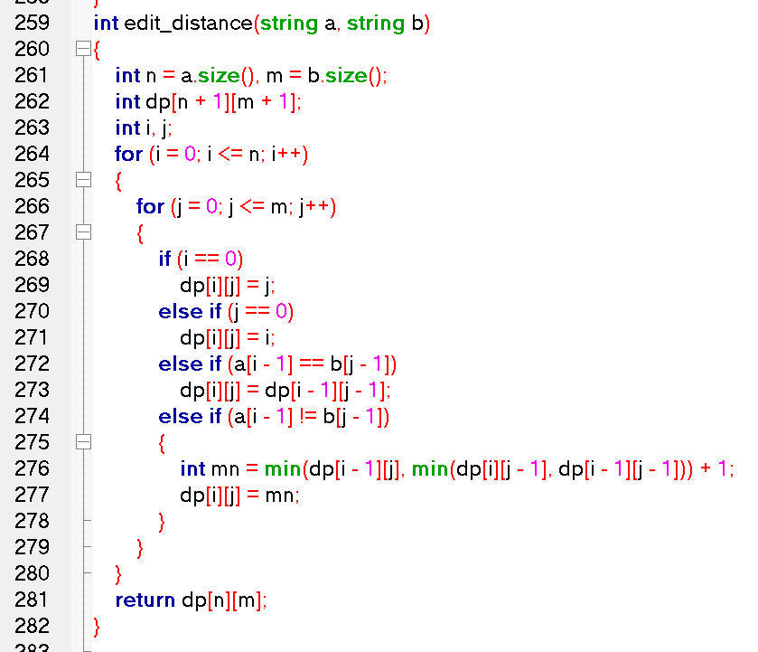
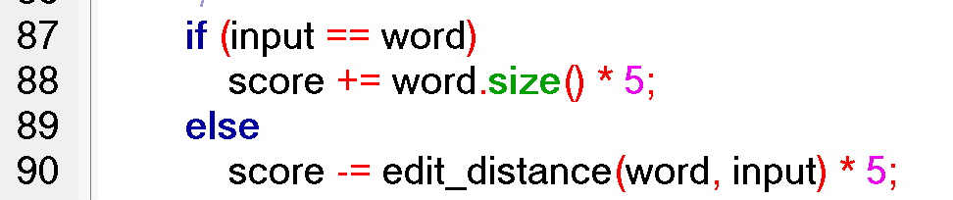
21
Game: Fast Typer
To make the game challenging, a score will be calculated.
If user type correct word score will increase 5 * word_length. Otherwise will decrease by 5 * edit_distance.
Code example: Score calculation
Code example: Edit Distance Algorithm

Slide 22
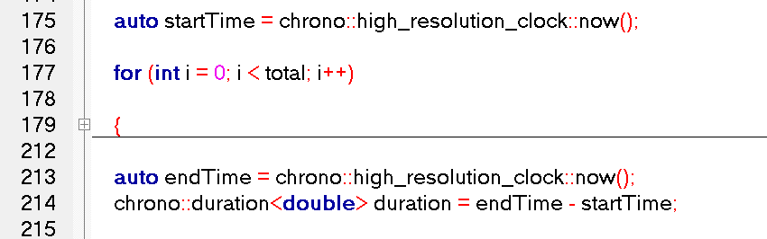
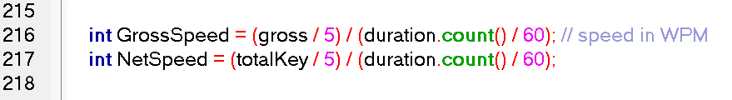
22
Typing Time Calculation and Timer
Code example: Calculation of typing duration
Code example: Gross Speed & Net Speed calculation

Slide 23
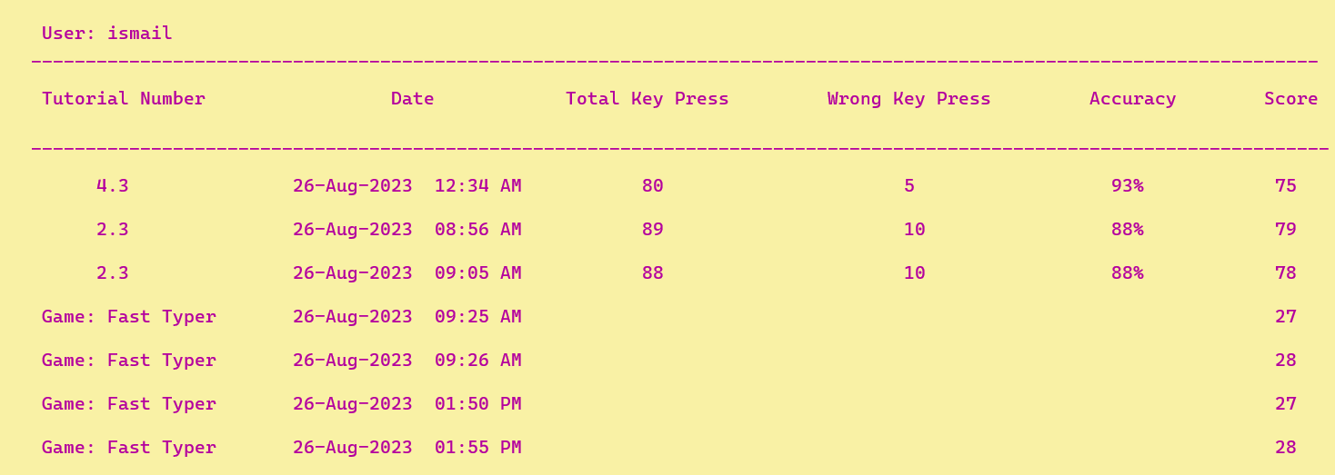
23
Performance History
Each users’ performance history will be stored in separate text file

Slide 24
24
Summery
Language: C++
Lines of code: 1500+
Project Link:
SPL - 1

Slide 25
25
Future scope
Enhanced User Interface
Multiplayer Functionality
Additional Game Modes

Slide 26
26
Project Demonstration

Slide 27
27
Thank You

